Slide 1
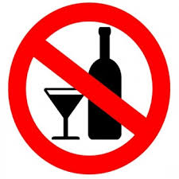
Alcohol Ban in Saudi Arabia
Drinking of alcohol is prohibited under Islam. Some countries in the Middle East and other parts of the world have banned alcohol in their countries.
Saudi Arabia follows strict religious law. Under this religious alcohol is banned in Saudi Arabia.
Therefore citizens cannot drink alcohol in the whole country.
Those who break this law are
punished.
Religious Courts punish individuals who
drink alcohol. (WF-2017)
Notes:
https://www.worldatlas.com/articles/14-countries-where-drinking-alcohol-is-illegal.html World Facts 14 countries where alcohol is illegal. 2017.

Slide 2
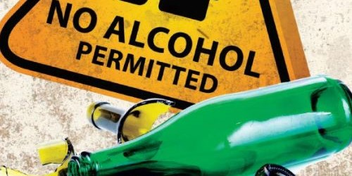
Alcohol Ban in Saudi Arabia contd.
It is not only illegal to drink in Saudi Arabia it is also illegal to make alcohol. It is illegal to import alcohol as well. There is severe punishment for those who sell alcohol. Consumption of alcohol is also prohibited. Citizens who break this law are punished.
(WF-2017)
Notes:
https://www.worldatlas.com/articles/14-countries-where-drinking-alcohol-is-illegal.html World Facts 14 countries where alcohol is illegal. 2017.

Slide 3

Five Reasons why alcohol is forbidden in Islam
Prayer is compulsory and alcohol and prayer do not mix.
Alcohol is addictive
Alcohol makes mental activity difficult.
One forgets if one drinks alcohol
Alcohol can lead to crime.
(Source: ‘Why Muslism don’t
Drik alcholol’)
Notes:
Zaulfishan, ‘Why Muslims don’t drink alcohol, 2011 Retrieved from https://www.greenprophet.com/2011/11/muslims-alcohol-haraam/

Slide 4
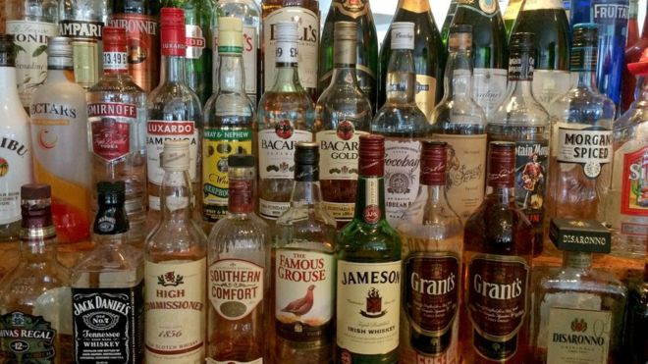
Expatriates and Alcohol Ban
Expatriates can brew their own liquor. They are not allowed to drink in the open. However, if they are living in a compound where other expatriates stay they can consume alcohol. In the compounds they can have parties without disturbing the peace. The police will not generally enter in the compounds where expatriates live.
Notes:
Ref: Cacciottolo, Mario, ‘Saudi Arabia, drinking: The Risk expats take for a tipple,’ 2015
https://www.bbc.com/nws/uk-3451614 3

Slide 5

Expatriates and Alcohol Ban
Expatriates can be imprisoned if they are found drinking outside compound. (BBC-2015) Before they enter the country, many expatriates were informed of the ban on alcohol consumption. They chose to ignore the warning and are caught drinking in the public. There were several cases of expatriates caught drinking on beaches. It is important for the expatriates to follow the law of
the land.
Notes:
Ref: Cacciottolo, Mario, ‘Saudi Arabia, drinking: The Risk expats take for a tipple,’ 2015
https://www.bbc.com/nws/uk-3451614 3

Slide 6

Punishment – Drinking Alcohol
Drinking alcohol in Saudi Arabia is a serious crime.
The punishment is very severe.
If found guilty of for drinking alcohol by the courts, the individual will get corporal punishment.
The courts have often punished the individuals found guilty of this type of crime.
As a punishment the individual can get
up to 500 lashes in public.
(Source: https://www.bankerinthesun.com/2014/09/crime-and-punishment-in-saudi-arabia/0
Notes:
‘Crime and Punishment in Saudi Arabia’, https://www.bankerinthesun.com/2014/09/crime-and-punishment-in-saudi-arabia/

Slide 7
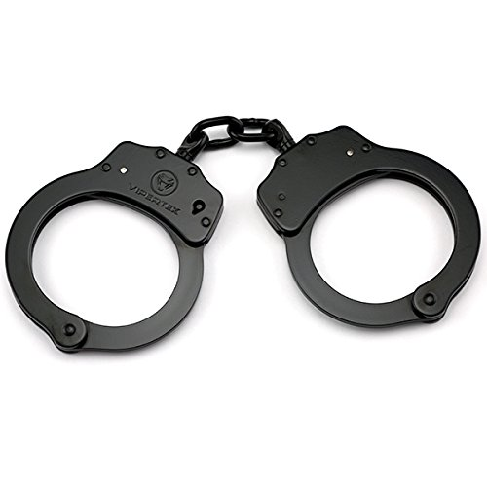
Punishment contd.
There is a separate punishment for selling alcohol.
For selling alcohol one can even be imprisoned for many years.
Some people are given the punishment of 500 lashes in public by the religious courts.
In recent times some expatriates were found guilty of selling home made alcohol and punished
by the religious courts.
Taking the risk of getting punished for
making some money does not make
any sense. (SA-2014)
Notes:
‘Crime and Punishment in Saudi Arabia’, https://www.bankerinthesun.com/2014/09/crime-and-punishment-in-saudi-arabia/

Slide 8
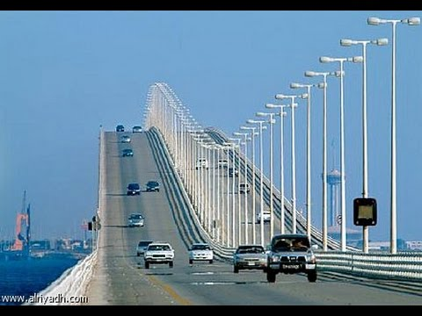
Saudi Arabian Citizens and
Alcohol
Bahrain is very attractive to Saudi Arabian citizens because it is legal to sell and drink alcohol there.
Saudi citizens who live in one of the most conservative country regularly cross the connecting bridge to travel to Bahrain to drink alcohol.
Saudi Arabia and Bahrain are connected with a road and a bridge.
It is easy to reach Bahrain within half an hour for Saudi citizens living near the border.
They can have drink alcohol and go back to their conservative society within a few hours, says Rebecca Santana in an article. (Santana-2009)
Notes:
Santana, Rebecca, Bahrain’s allure for Saudis extends beyond alcohol,’ The San Diego Union Tribune, 2009, https://www.sandiegouniontribune.com/sdut-ml-bahrain-saudis-vacation-072109-2009jul21-story.html

Slide 9
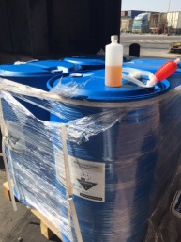
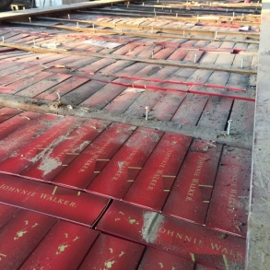
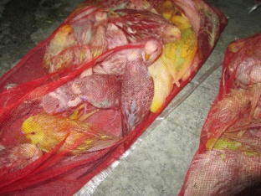
Citizens trying to smuggle alcohol in Saudi Arabia
Despite strict laws and vigilant custom officers, some citizens use novel methods to smuggle alcohol in the country.
An article in the Washington Post published a number of tweets from the customs on methods used by the people to smuggle alcohol in the country. (Taylor-2016)
Inside industrial looking containers .
In the crates that are fake.
Alcohol smuggled inside the birds.
Notes:
Ref: Taylor, Adam, ‘Smugglers keep trying to get alcohol into Saudi Arabia and customs officials keep tweeting it,’ Washington Post, Jan 2016 https://www.washingtonpost.com/news/worldviews/wp/2016/01/31/smugglers-keep-trying-to-get-alcohol-into-saudi-arabia-and-customs-officials-keep-tweeting-it/?noredirect=on&utm_term=.4e86517d0001

Slide 10

Report of World Health Organization
World Health Organization has collected data on substance abuse in Saudi Arabia.
The report says the per capita age of consumers is 15+.
There is a big growth in the alcohol use in Saudi Arbia.
The number of people consuming alcohol has shown a high trend in five years before 2003.
List of abstainer is diminishing.
(Sources: FAO (Food and Agriculture Organization of the United Nations), World Drink Trends 2003)
Notes:
Ref: http://www.who.int/substance_abuse/publications/en/saudi_arabia.pdf Saudi Arabia Substance Abuse

Slide 11
Report of World Health Organization contd.
The report of the World Health Organization on abuse of alcohol and other substances in Saudi Arabia has the following data.
  In Al Amal Hospital in Riyadh data showed that alcohol was used by 23.75% of male patients.
  The data was gathered from 160 male patients who were 20 and older.
  In Dammam, out of 120 male patients in the Hospital 12.5% had alcohol abuse.
  In 1995, unrecorded alcohol consumption was 0.6 litres per capital for over 15 years people.
Notes:
Ref: http://www.who.int/substance_abuse/publications/en/saudi_arabia.pdf Saudi Arabia Substance Abuse

Slide 12

Perception of medical Students on Alcoholism in Saudi Arabia
A study was conducted to find the perception of medical student on alcoholism in Saudi Arabia.
Two hundred and fifteen students took part in the survey.
75% think alcoholism is a problem in the community.
Students think that the problem is present only in the young unmarried men.
Older students and doctors thought that the problem is more serious. (Al-Haqwi-2010)
Notes:
Al-Haqwi, Ali Perception among medical students in Riyadh, Saudi arabia, regarding alcohol and substance abuse in the community: a cross-sectional survey, 2010, NCBI Resources. Retrieved from https://www.ncbi.nlm.nih.gov/pmc/articles/PMC2832638/

Slide 13

Perception of medical Students on Alcoholism in Saudi Arabia contd.
Students thought that the friends and peers influenced the young men to try alcohol.
Stress is one cause of alcoholism.
Curiosity is another factor that
leads to use of alcohol and alcoholism.
Study shows though the research is limited in the country, there is an increase of outpatients and inpatients in the mental hospitals who suffer from alcoholism.
It is important for the people who are treating patients to show empathy and do not treat alcoholism as law and order problem. (Al-Hawai-2010)
Notes:
Al-Haqwi, Ali Perception among medical students in Riyadh, Saudi arabia, regarding alcohol and substance abuse in the community: a cross-sectional survey, 2010, NCBI Resources. Retrieved from https://www.ncbi.nlm.nih.gov/pmc/articles/PMC2832638/

Slide 14

Treatment for Saudi citizens for alcoholism.
In the past Saudi citizens who wanted to join a rehab for alcoholism had to go abroad to get treatment.
Recently, an article published by a rehab in Thailand mentioned that Saudi Ministry of Health is now trying to help their citizens in Saudi Arabia.
Saudi Ministry of Health is trying to cater to the rehab program of the Saudi citizens who suffer from alcoholism.
Dr. Khaled Al-Mirghalani with Saudi Arabia’s
Ministry of Health, said the Saudi Arabia presently
have 18 hospitals that, “cater for mental patients
and drug addicts.” (DARA-2018)
He also said that the Ministry of Health
is going to build a 500 bed mental
health hospital in Riyadh with facilities
to treat patients with drug addictions. (DARA-2018)
Notes:
Ref: DARA Thailand, Rehab in Thailand. https://www.dararehab.com/drug-alcohol-rehab/saudi-arabia/

Slide 15
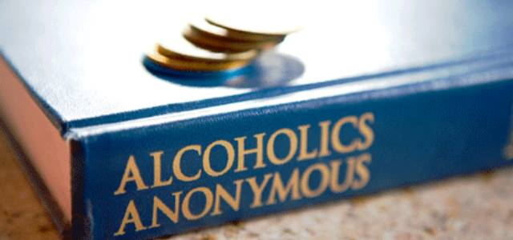
Saudi Arabia’s
Alcoholics Anonymous
Alcoholic Anonymous is a world wide movement that helps the alcoholics to get rid of the addiction.
AA has established groups that meet in many countries in the Middle East including Saudi Arabia under MERCAA.
There are two types of meeting for AA groups
Open meeting, anyone interested in AA can attend
Closed meeting, where only AA members who want to stop drinking attend the meetings.
(https://sites.google.com/site/aasaudiorg/
Notes:
Ref: https://sites.google.com/site/aasaudiorg/

Slide 16

Saudi Arabia’s Alcoholics
Anonymous contd.
Alcoholic Anonymous thinks alcoholism is a ‘progressive disease.’
AA wants you to ask the question why are you an alcoholic and seek the answer.
AA helps you with your drinking problem.
AA is not a religious organization nor it is joined with any religion.
AA says people will recover from alcoholism if they follow the routine prescribed.
(Source: https://sites.google.com/site/aasaudiorg/for-new-comers)
Notes:
Ref. Saudi Arabia’s Alcoholics Anonymous https://sites.google.com/site/aasaudiorg/

